Slide 1
[STATE NAME]
[DEPARTMENT NAME]
National DPP Lifestyle Change Program Process Flow
This presentation was created by NACDD and Leavitt Partners, in collaboration with the Maryland Department of Health through their 6|18 initiative, through grant funding from the CDC. Any questions about this presentation and its use should be directed to coveragetoolkit@chronicdisease.org
Content last updated 7/28/22
This set of slides contains both internal and external links that can be clicked for navigation purposes or to get more information on a specific topic.

Slide 2
Purpose of this Presentation Deck
This slide deck is intended to be a resource for state health departments, Medicaid agencies, and/or other key stakeholders.
Stakeholders are not required to use this process or flow structure. The slides were developed to give a general example overview of the process of enrolling a participant into and completing the National DPP lifestyle change program.
While this presentation can be used as-is, users are encouraged to augment these slides with information specific to your State/institution.
Please note: there are several locations where hyperlinks have been included. These links go to external websites as well as link back to other sections within this presentation. Removing slides may modify internal link capabilities.
The external links were accurate and worked appropriately at the time this slide deck was developed. External sites may have been modified in the interim. As a result, we cannot guarantee the accuracy of any external link contained in this document. Always double check the links you intend to use before presenting.

Slide 3
Pre-screening entity / method
Is additional information or testing required to confirm eligibility?
Referral to CDC-recognized organization
Intake
Contact the referring provider to order additional testing
Potential Participant Identified
Run required test(s) / collect info
Is the participant eligible to enroll in the National DPP lifestyle change program?
National DPP lifestyle change program selection based on Health Plan Provider/Supplier Network
Participant Enrolled
Participant is not eligible for the program at this time. Inform referring entity & make other referrals as appropriate.
Feedback provided to referring entity or provider
Participant attends scheduled sessions
Participant’s insurance or Medicaid billed for each session
Data reported to CDC/DPRP
Yes
No

Slide 4
Participant Pathway
Steps
Refer
Using the referral pool, identify potentially eligible participants.
Sequential Steps
Pay for
Determine who will be paying for the participant to attend the program.
Choose
Determine which type of program the participant prefers to attend.
Qualify
Confirm that the participant is eligible to participate, meeting all program inclusion criteria.
Enroll
Enroll the participant into the appropriate National DPP lifestyle change program.
Attend
Participant attends and completes in-person or virtual classes and participates in the required activities.
Data Reporting
Feedback is provided to the referring entity/provider and data is provided to the CDC/DPRP.
Return to flow overview

Slide 5
Participant Pathway
Referral Sources
Refer
Referral Pool
Pay for
Choose
Provider Referral*
Participant Self-referral
Employer Referral
Qualify
Hospital System Referral
MCO/Payer Referral
Other Referral Sources
Enroll
Community Org Referral
Attend
Data Reporting
*Health Care Provider
Return to flow overview

Slide 6
Participant Pathway
Referral Sources
Refer
Pre-screening Resources:
CDC Risk Test
ADA Risk Test
Mike’s Journey (video)
Dionne’s Journey (video)
Referral Pool
Pay for
Provider Referral
Participant Self-referral
Employer Referral
Choose
Hospital System Referral
MCO/Payer Referral
Other Referral Sources
Qualify
Community Org Referral
Enroll
Unique considerations for a participant who self-refers:
May result from National DPP lifestyle change program marketing (i.e. promotional prediabetes video, flyers, post cards, or other sources).
Participants can self-refer by taking the prediabetes risk test and meeting the score to be considered eligible for the National DPP lifestyle change program.
Attend
Data Reporting
Return to flow overview

Slide 7
Participant Pathway
Referral Sources
Refer
Pre-screening Resources:
CDC Risk Test
ADA Risk Test
Coverage Toolkit
Claims data/eligibility algorithm
Referral Pool
Pay for
Provider Referral
Participant Self-referral
Employer Referral
Choose
Hospital System Referral
MCO/Payer Referral
Other Referral Sources
Qualify
Community Org Referral
Enroll
Unique considerations for a participant referred by an MCO or payer:
MCOs/payers may use claims data (at least 3 months lag time) to search for eligible members based on the CDC prediabetes eligibility criteria.
May require marketing (i.e. flyers, post cards, phone calls, email, text messages) through the companies'/customer’s preferred communication method.
Attend
Data Reporting
Return to flow overview

Slide 8
Participant Pathway
Referral Sources
Refer
Pre-screening Resources:
CDC Risk Test
ADA Risk Test
Coverage Toolkit
EHR data/eligibility algorithm
Referral Pool
Pay for
Provider Referral
Participant Self-referral
Employer Referral
Choose
Hospital System Referral
MCO/Payer Referral
Other Referral Sources
Qualify
Community Org Referral
Enroll
Unique considerations for a participant referred by a medical provider:
Providers may identify and refer a patient based on their results on one of three qualifying blood tests.
Providers may repeat the same test on a second day or may do a different test prior to diagnosing and confirming diagnosis of prediabetes.
Providers and medical staff may use EHR data to pre-identify patients who meet the eligibility criteria.
Risk tests may be administered by primary care physicians as well as other health professionals such as registered nurses, physician assistants, dentists, ophthalmologists, pharmacists, etc. The risk test may also be administered by other medical office staff.
Attend
Data Reporting
Return to flow overview

Slide 9
Participant Pathway
Referral Sources
Refer
Pre-screening Resources:
CDC Risk Test
ADA Risk Test
Coverage Toolkit
EHR data/eligibility algorithm
Referral Pool
Pay for
Provider Referral
Participant Self-referral
Employer Referral
Choose
Hospital System Referral
MCO/Payer Referral
Other Referral Sources
Qualify
Community Org Referral
Enroll
Unique considerations for a participant referred by a hospital system:
Providers may identify and refer a patient based on their results on one of three qualifying blood tests.
Providers may repeat the same test on a second day or may do a different test prior to diagnosing and confirming diagnosis of prediabetes.
Hospitals can utilize their EHR to pre-identify patients who meet the eligibility criteria.
Hospitals without an in-house National DPP lifestyle change program can contract with one or more community-based or online CDC-recognized organizations.
Risk tests may be administered by primary care physicians as well as other health professionals such as registered nurses, physician assistants, dentists, ophthalmologists, pharmacists, etc. The risk test may also be administered by other medical office staff.
Attend
Data Reporting
Return to flow overview

Slide 10
Participant Pathway
Referral Sources
Refer
Pre-screening Resources:
CDC Risk Test
ADA Risk Test
Mike’s Journey (video)
Dionne’s Journey (video)
Referral Pool
Pay for
Provider Referral
Participant Self-referral
Employer Referral
Choose
Hospital System Referral
MCO/Payer Referral
Other Referral Sources
Qualify
Community Org Referral
Enroll
Unique considerations for a participant referred by a
community organization:
May require marketing (e.g., promotional prediabetes video, flyers, post cards, etc.).
Potential participants can self-refer by taking the prediabetes risk test and meeting the score to be considered eligible for the National DPP lifestyle change program.
Attend
Data Reporting
Return to flow overview

Slide 11
Participant Pathway
Referral Sources
Refer
Pre-screening Resources:
CDC Risk Test
ADA Risk Test
Coverage Toolkit
Mike’s Journey (video)
Dionne’s Journey (video)
Referral Pool
Pay for
Provider Referral
Participant Self-referral
Employer Referral
Choose
Hospital System Referral
MCO/Payer Referral
Other Referral Sources
Qualify
Community Org Referral
Enroll
Unique considerations for a participant referred by an employer:
Employers may have health insurance company use claims data (3 months lag time) to search for eligible members based on the CDC prediabetes eligibility criteria.
Employees can self-refer by taking the prediabetes risk test and meeting the score to be considered eligible for the National DPP lifestyle change program.
Employers may do a wellness assessment of their organization to justify offering the National DPP lifestyle change program and follow-up with employees who indicated interested.
May require marketing (e.g., flyers, post cards, phone calls, email, text messages) through the companies'/employee’s preferred communication method.
Attend
Data Reporting
Return to flow overview

Slide 12
Participant Pathway
Referral Sources
Refer
Pre-screening Resources:
CDC Risk Test
ADA Risk Test
Coverage Toolkit
Mike’s Journey (video)
Dionne’s Journey (video)
Referral Pool
Pay for
Provider Referral
Participant Self-referral
Employer Referral
Choose
Hospital System Referral
MCO/Payer Referral
Other Referral Sources
Qualify
Community Org Referral
Enroll
Additional Referral Sources:
State health information exchanges (HIEs)
Local Health Departments (LHDs)
Chronic Disease Self Management Program (CDSMP) and Diabetes self-management education (DSME) and support programs
Attend
Data Reporting
Return to flow overview

Slide 13
Participant Pathway
Payment Options
Refer
Who is paying for their participation in the National DPP lifestyle change program?
Pay for
Choose
Qualify
Participant
Self-payment
Employer or other 3rd party
Participant’s Insurance
Enroll
Pull list of participating CDC-recognized organizations within payer’s network.* Continue to Program Type Options.
Attend
Yes
Data Reporting
No
*Self-payers may choose any CDC-recognized organization
Return to flow overview

Slide 14
Participant Pathway
Program Options
Refer
Participant choses a delivery mode from the list of DPPs available in payer’s network.
Pay for
Review the list of DPPs available in payer’s network⁺, or otherwise available, who are accepting new participants.
Choose
Qualify
In-person
Online / Telehealth
In-person / Online Hybrid
Enroll
Attend
Participant selects preferred organization and referral is initiated.
Data Reporting
Self-payers may choose any CDC-recognized organization
+ Participants choosing a CDC-recognized organization outside of their insurance network may be responsible for a portion of the payment.
Return to flow overview

Slide 15
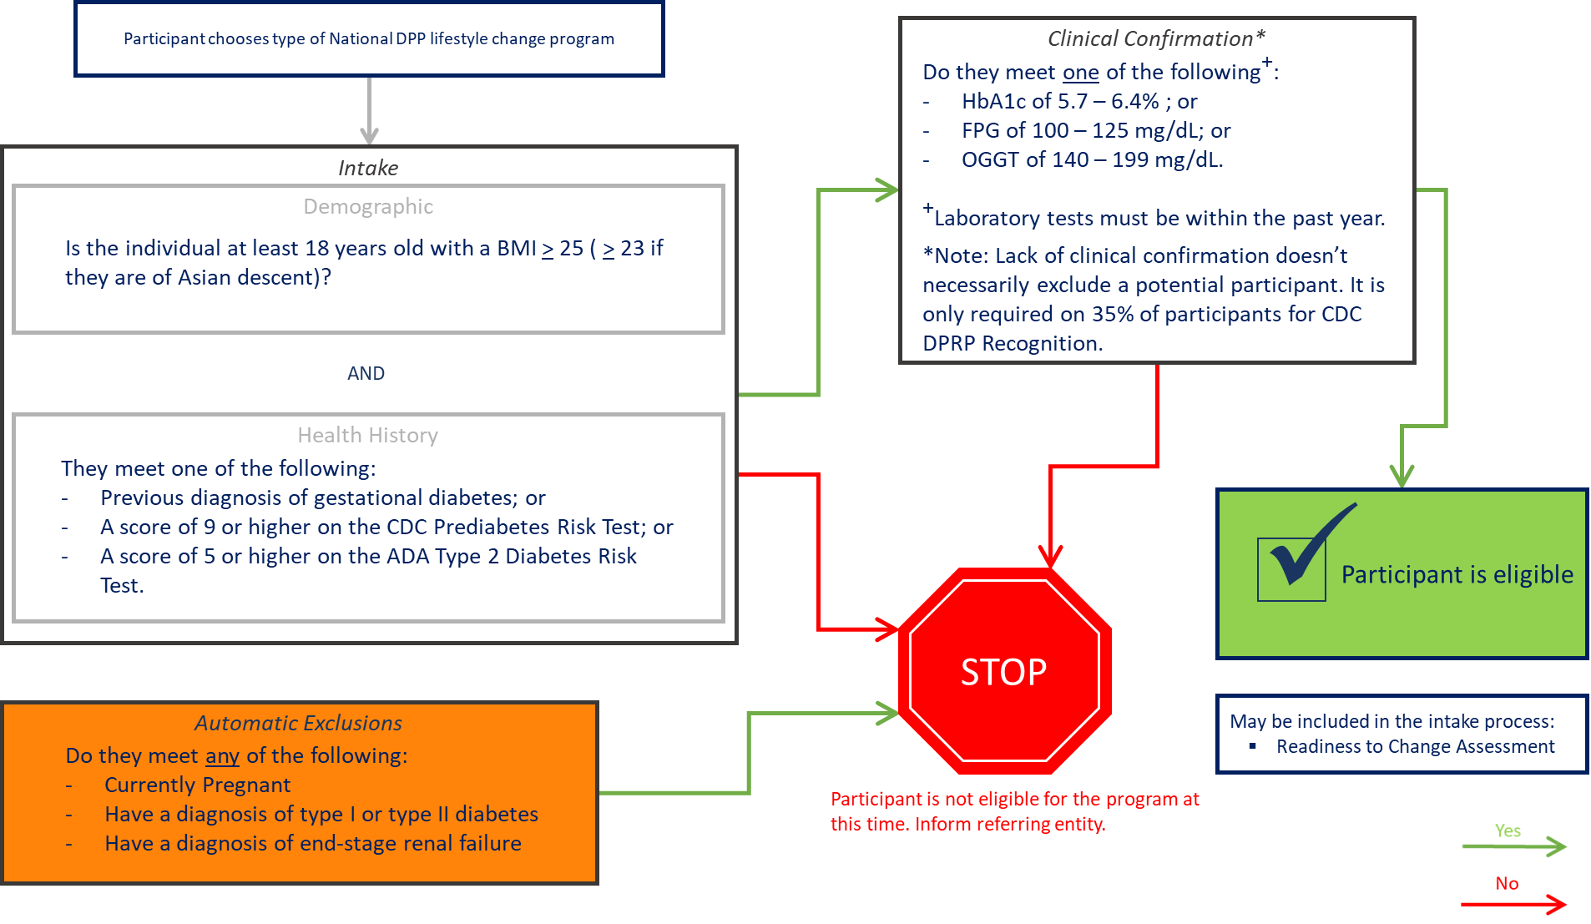
Participant Pathway
Eligibility Decision Tree
Refer
t
Pay for
Choose
Qualify
Enroll
Attend
Data Reporting
The eligibility criteria for the MDPP differ slightly from those pictured above. For more information, please see the coveragetoolkit.org website.
Return to flow overview

Slide 16
Participant Pathway
Common Enrollment Needs
Refer
Participants who are Self-Referred, Community Organizations and Employer Wellness Programs
Pay for
Reason for Referral
Score on risk test
DoIHavePrediabetes Campaign
Suspicion of prediabetes
  Must confirm all qualification elements
State and Local public marketing campaigns
Told by a provider they are at risk for developing type 2 diabetes
Choose
Qualify
Enroll
Eligibility Confirmation Needed
Diagnosis of Obesity
  BMI calculation, or
  Medical Diagnosis
Qualifying Blood Test
  HbA1c, FPG, or OGTT
Detailed Health History
Attend
Data Reporting
Return to flow overview

Slide 17
Participant Pathway
Common Enrollment Needs
Refer
Participants Referred from MCOs, Other Payers, Medical Providers, & Hospitals or Health Systems
Pay for
Reason for Referral
Diagnosis of Obesity
  Medical Diagnosis (ICD-9 or ICD-10 code)
Qualifying Blood Test
  HbA1c, FPG, or OGTT
Detailed Health History
History of Gestational Diabetes
Choose
Qualify
Enroll
Eligibility Confirmation Needed
Depending on date of query, may need blood test or detailed health history to confirm inclusion/exclusion.
Attend
Data Reporting
Return to flow overview

Slide 18
Participant Pathway
Lifestyle Change Program Curricula
Refer
Introduction – Must occur first, per CDC.
Foundational Classes – Recommended to occur in this order per CDC.
Present all of these modules – Can occur in any order per CDC.
7. Burn More Calories Than You Take In
10. Find Time for Fitness
13. Take Charge of Your Thoughts
1. Intro to the Program
4. Eat Well to Prevent T2
16. Stay Motivated to Prevent T2
CDC recommends this class occur at the 6 month mark.
Pay for
0. Program Overview*
Months 1 – 6
2. Get Active to Prevent T2
5. Track Your Food
8. Shop and Cook to Prevent T2
11. Cope with Triggers
14. Get Support
Choose
*May be offered during session 1 if no session zero occurs.
3. Track Your Activity
6. Get More Active
9. Manage Stress
12. Keep Your Heart Healthy
15. Eat Well Away from Home
Qualify
Present at least six* of these modules – Can occur in any order per CDC.
Conclusion – Must occur last, per CDC.
Medicare Only
Year 2
Choose 12 modules from any approved curricula, presented monthly for year 2.
*Some DPPs may offer all 9 modules instead of 6
Month 7 – 12 module options
Enroll
17. CHOOSE ONE MODULE
20. CHOOSE ONE MODULE
Stay Active to Prevent T2
Stay Active Away from Home
More About T2
22. Prevent T2 – for Life!
Months 7 – 12
Attend
18. CHOOSE ONE MODULE
21. CHOOSE ONE MODULE
Get Enough Sleep
Get Back on Track
Take a Fitness Break
CHOOSE 12 MODULES
1. – 12.
19. CHOOSE ONE MODULE
22. CHOOSE ONE MODULE*
Have Healthy Food You Enjoy
When Weight Loss Stalls
More About Carbs
Data Reporting
Return to flow overview

Slide 19
Participant Retention in the National DPP Lifestyle Change Program
General Retention Strategies
Important Early Program Retention Milestones
Referring Provider Contact when a Participant Disengages
General strategies to boost retention include:
Use of incentives (if allowed)
CDC retention modules
Important retention modules
can be used at the after the following milestones:
Program Overview session
Get Active session
Track Your Activity session
Eat Well session
Track Your Food session
Get Support session
Week 16 module
A referring provider’s involvement can often boost success rates for their patients who participate.
If a participant disengages, the provider’s office can:
Contact the participant directly
Encourage continued participation in the NDPP lifestyle change program
Address concerns and commit participant to continue program
Return to flow overview

Slide 20
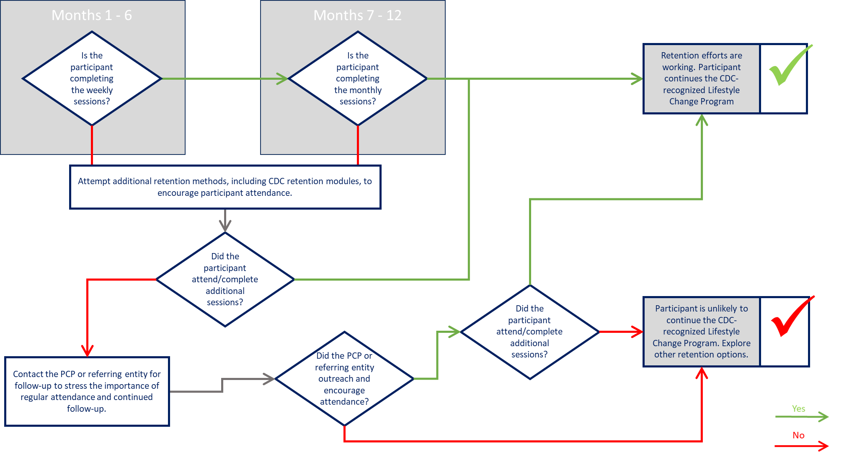
Participant Pathway
Retention Decision Tree
Refer
Pay for
Choose
Qualify
Enroll
Attend
Data Reporting
Return to flow overview

Slide 21
Participant Pathway
Refer
Two Separate Feedback Pathways Exist
Pay for
CDC / DPRP Recognition
Referring Entity / Provider
Choose
Data Reporting
  Standards for CDC-recognition
  The feedback required includes 24 data points found in Table 4 of the 2018 DPRP standards document
Qualify
Enroll
Attend
Data Reporting
Return to flow overview

Slide 22
Participant Pathway
Refer
Two Separate Feedback Pathways Exist
Pay for
CDC / DPRP Recognition
Referring Entity / Provider
Choose
Provide Feedback Regarding:
  - Enrollment
  - Individual Participant progress
    Attendance
    Weight Loss
    HbA1c and BMI changes
    Physical Activity
    Feedback Methods
    EHR
    Secure Email
    Mail
    Secure Fax
    State Data Platforms
Qualify
Enroll
Attend
Data Reporting
Return to flow overview

Slide 23
Coding and Billing Considerations for the National DPP Lifestyle Change Program
Billing Medicaid
Billing Medicare
Billing a Private Payer
When Billing Medicaid:
  Type of billing, claims versus invoice, depends on type of contract established with Medicaid
  Bill as established in physician fee schedule or invoicing requirements in contract
Use appropriate HCPCS/CPT codes, as directed by the state
  Include appropriate ICD-10 diagnosis codes
When Billing Medicare:
Bill at required timepoints
  After session 1
  After sessions 2 – 4
  After sessions 5 – 9
  After sessions 10-19 (at least 2 classes attended in months 7-9)
  After sessions 20-22 (at least 2 classes attended in months 10-12)
Use appropriate HCPCS codes
  Include appropriate ICD-10 diagnosis codes
  Glucose lab test required by Medicare to qualify
When Billing a Private Payer:
  Type of billing, claims versus invoice, depends on type of contract established with payer
  Bill as established in physician fee schedule or invoicing requirements in contract
Use appropriate HCPCS/CPT codes
  Include appropriate ICD-10 codes
  May not be required when invoicing – depends on type of contract established with payer
Return to flow overview

Slide 24
Information about Testing and Medical History to Qualify for the National DPP Lifestyle Change Program
Body Mass Index (BMI)
The BMI looks at the ratio of a person’s weight and height (weight in kg/ height in m2). This can be used as an indicator of obesity. The CDC provides a calculator to measure BMI in adults.
Hx of Gestational Diabetes
Gestational diabetes is a condition developed during pregnancy affecting how the body responds to glucose (i.e. sugar). This is similar to other types of diabetes, but blood sugar often returns to normal soon after delivery. It is most common in women over 25 years old, women who have a personal or family history of the condition, women who have a BMI of 30 or greater, and women of minority races.
CDC Prediabetes Risk Test
The CDC provides a risk test to measure if someone is at risk for prediabetes. This test incorporates age, family history, and several health-related elements.
ADA Type 2 Diabetes Risk Test
The ADA provides a risk test to measure if someone is at risk for diabetes. It incorporates age, family history, and several health-related elements. This test is also available in a paper version.
Hemoglobin A1C
This blood test, also referred to as A1c, HbA1c, glycated hemoglobin, and glycohemoglobin, measures the average level of blood sugar over the past 2 to 3 months. Values between 5.7% and 6.4% may indicate prediabetes. This test must be interpreted by a licensed clinician for a diagnosis to be made.
Fasting Plasma Glucose
This blood test, also referred to as FPG, is drawn after someone has not eaten anything for at least eight hours. It measures the level of blood glucose (i.e. sugar) when fasting. Values between 100 to 125 mg/dL may indicate prediabetes. This test must be interpreted by a licensed clinician for a diagnosis to be made.
Oral Glucose Tolerance Test
This test, also referred to as OGTT, is performed by taking a baseline blood sample, then having the individual drink a liquid that contains a known amount of glucose. Blood is then drawn according to a set time schedule to measure how the body responds to the glucose. Values between 140 and 200 mg/dL may indicated prediabetes. This test must be interpreted by a licensed clinician for a diagnosis to be made.
Return to flow overview

