Slide 1
Prediabetes Is Affecting Your Members: How You Can Help
[Insert agency/ organization logo]
Notes:
[WELCOME participants, introduce yourself and your organization. THANK THEM for taking the time to discuss the important topic of how prediabetes is affecting their members and how they can help.]
[SHARE that lifestyle change programs like your program are part of the National Diabetes Prevention Program, led by the Centers for Disease Control and Prevention. The National Diabetes Prevention Program is a public-private partnership of community organizations, private insurers, employers, health care organizations, faith-based organizations, and government agencies.]
[INSERT any personal comments.]

Slide 2

OUTLINE OF PRESENTATION
Presentation Outline
How prediabetes is affecting your beneficiaries and state Medicaid program
Benefits of the CDC-recognized lifestyle change program
What you can do
Notes:
Today we’ll briefly cover a few key topics:
How prediabetes is affecting your beneficiaries and state
Benefits of the CDC-recognized lifestyle change program
What you can do to bring this program to your members

Slide 3

Prediabetes
A Growing Issue with Serious Consequences for YOUR STATE
Notes:
Prediabetes is a growing health care issue with serious health and cost consequences.

Slide 4
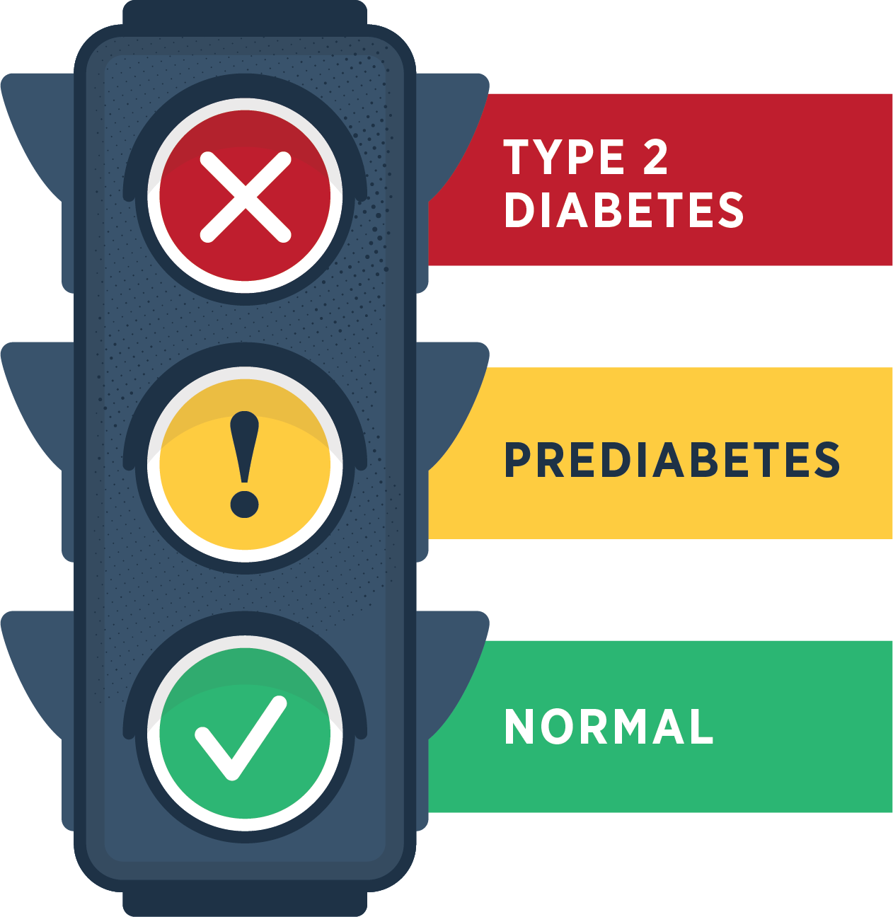
Prediabetes is when your blood sugar level is higher than normal but not high enough yet to be diagnosed as type 2 diabetes.
Notes:
Prediabetes is when your blood sugar level is higher than normal but not high enough yet to be diagnosed as type 2 diabetes

Slide 5


Adults has prediabetes
8
>
Don’t know they have it
Notes:
An estimated 96 million American adults—that’s more than 1 out of 3—and likely a significant number of your employees— have prediabetes. More than 8 out of 10 don’t even know they have it.

Slide 6

Consider highlighting STATE SPECIFIC prevalence and burden data
Diabetes
Prediabetes
Hospitalizations
Medical Costs
Mortality
Other
Notes:
https://nccd.cdc.gov/Toolkit/DiabetesBurden/Home
https://www.diabetes.org/about-us/statistics/by-state

Slide 7
Without lifestyle changes, people with prediabetes can develop type 2 diabetes.
The number of adults with diagnosed diabetes quadrupled from 1980 to 2014.
2 in 5 adults in the U.S. could have diabetes by 2060 if nothing changes.
!
Notes:
Unless they make lifestyle changes, many people with prediabetes will develop type 2 diabetes within a few years.
In fact, diabetes in adults has increased at an alarming rate in the past two decades and it is estimated that 2 in 5 adults in the United States could have diabetes by 2060 if nothing changes. That’s your current AND future workforce.
https://pophealthmetrics.biomedcentral.com/articles/10.1186/s12963-018-0166-4

Slide 8
People with type 2 diabetes are at higher risk of serious health complications
Kidney failure
blindness
Loss
of toes, feet, or legs
Heart attack
stroke
Notes:
People with type 2 diabetes are at higher risk of serious health complications including kidney failure, blindness, heart attack, stroke, and loss of toes, feet, or legs.

Slide 9

When prediabetes turns into type 2 diabetes…

Slide 10
HEALTH CARE DOLLARS IS SPENT ON PEOPLE DIAGNOSED WITH DIABETES
Diabetes is the COSTLIEST disease in the U.S. at
$412.9 BILLION in 2022.
Cost of care for people
with diabetes is 2.6 times more than for those
without diabetes.
Annual medical expenditures
in 2022 were $19,736 per person diagnosed with diabetes.
1
4
IN
Estimate your costs and benefits using CDC’s return on investment (ROI) calculator: https://nccd.cdc.gov/Toolkit/DiabetesImpact
Notes:
Diabetes is the costliest of the 155 most common diseases in the country, at $412.9 billion in 2022, including $306.6 billion in direct medical costs and $106.3 billion in indirect costs
Cost of care for people with diabetes in 2022 was responsible for 1 in every 4 U.S. health care dollars spent, and annual medical expenditures were $19,736 per person with diagnosed diabetes—2.6 times more than for those without diabetes.
To estimate the costs and benefits in your situation, you can use CDC’s return on investment (or ROI) calculator: https://nccd.cdc.gov/Toolkit/DiabetesImpact
https://diabetesjournals.org/care/article/47/1/26/153797/Economic-Costs-of-Diabetes-in-the-U-S-in-2022

Slide 11




Top-of-Mind Issues for Medicaid Leaders
Rapidly Changing Program Priorities/Needs
Managed Care Reform
Social Determinants of Health
Delivery & Payment System Reform
Notes:
We know there is value to Medicaid in focusing on the prevention of a high-cost disease like type 2 diabetes, and public health, Medicaid agencies, and Medicaid managed care organizations are the perfect partners to problem solve how to
reimburse community-based providers,
using a value-based payment model,
for offering a year-long lifestyle change program to eligible Medicaid beneficiaries,
a program that also has the opportunity to address social of determinants of health due to its length and multiple touchpoints in a community setting.
Offering this program in Medicaid could actually provide an opportunity to address some of the Top-of-Mind issues facing Medicaid today.

Slide 12

The National Diabetes Prevention Program (National DPP)
Lifestyle Change Program
A solution
Notes:
There is a solution to the problem of prediabetes.

Slide 13
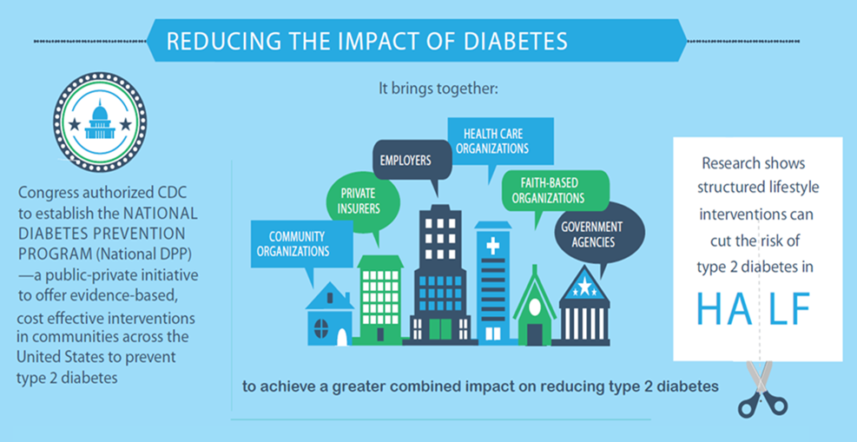
National Diabetes Prevention Program
All Payer Model
Medicaid
Medicare
State health plans
Commercial health
plans
Employers
Health Equity
https://www.cdc.gov/diabetes/prevention
Notes:
The National Diabetes Prevention Program is meant to be an all-payer model, and much of the work that CDC and partners are doing right now is to expand the reach and coverage of this program so that all payers are involved – Medicare, Medicaid, state health plans, commercial health plans, and employers.

Slide 14

Health Equity
Increasing Coverage and Access
Ensure coverage by both private and public payers
Coverage of the National DPP for at-risk populations
Adult Medicaid beneficiaries are more likely to develop type 2 diabetes than non-Medicaid adult populations
States that expanded Medicaid have seen their diabetes rates
increase in their Medicaid populations
Notes:
This all-payer model supports health equity and access, especially when Medicaid beneficiaries are covered, since adult Medicaid beneficiaries are more likely to develop type 2 diabetes compared to their non-Medicaid counterparts, and states that have expanded Medicaid have seen their type 2 diabetes rates increase in their Medicaid population.

Slide 15

Program quality and adherence to scientific standards monitored by CDC
A full year of support
Community-based or online
Cost-effective
CDC-approved curriculum in English and [insert if program is offered in other languages]
Notes:
The program is part of the National Diabetes Prevention Program, led by the Centers for Disease Control and Prevention, and offers a full year of support.
It can prevent or delay type 2 diabetes in high-risk individuals, such as those with prediabetes.
Accessibility is key for participation, so the program is currently offered in our community, at [insert locations] and online.
The program uses a CDC-approved curriculum and is monitored by CDC to ensure quality and adherence to scientific standards.
The cost per person is relatively low, depending on factors such as promotion, recruitment, staff, and logistics costs. The cost of preventing diabetes is typically much lower than the cost of dealing with the disease’s consequences.
It’s cost-effective and can be cost-saving through reductions in health care spending.

Slide 16
The National DPP Lifestyle Change Program
WORKS!
58%
Can prevent or delay type 2 diabetes by
Notes:
This program works. And it will work for your members.
Research examining the effects of a structured lifestyle change program like ours showed that losing 5 to 7 percent of body weight by eating healthy and increasing physical activity reduced the risk of developing type 2 diabetes by 58 percent in people at high risk for the disease. In individuals over 60 years old, it reduced risk by 71 percent.
Evidence is based on a large, rigorously designed randomized control trial with a diverse population.
The impact of the lifestyle intervention was similar, regardless of race, ethnicity, or gender.
Even after 10 years, those who participated in the earlier lifestyle change program had a 34 percent lower rate of type 2 diabetes.

Slide 17
Testimonial can go here and be a few lines long.
—First Last name
Notes:
[This should be a positive comment from a previous participant, especially if they were Medicaid eligible]. Ask a local CDC-recognized organization for a testimonial from someone in your state.
Testimonials available here: https://nationaldppcsc.cdc.gov/s/article/Testimonials-from-Participants

Slide 18
Testimonial can go here and be a few lines long.
—First Last name

Slide 19

What can you do?
It can help you lower health care costs—keeping costs down for your state and improving beneficiaries’ quality of life.
Work with National DPP providers to promote the program to your beneficiaries by engaging health care providers and outreaching eligible beneficiaries by phone, text message, and emails.
Consider offering this program as a statewide benefit or through engagement with managed care
Notes:
How can you help your state address prediabetes and prevent cases of type 2 diabetes? Establish Medicaid coverage for the National DPP lifestyle change program at the state level through your existing Medicaid State Plan, submitting a State Plan Amendment, creating or adapting an 1115 waiver, or using another mechanism, such as the legislative process. You can also engage managed care organizations to offer the program as a value-added service or to pilot the program in an effort to advance statewide coverage.
You can use CDC’s cost calculator available at https://nccd.cdc.gov/Toolkit/DiabetesImpact to estimate ROI or visit the Case for Coverage page (https://coveragetoolkit.org/medicaid-agencies/case-for-coverage/) on the Coverage Toolkit to use the Budget Projection Template for a cost assessment of offering the program in Medicaid.
Once coverage is established or offered by a managed care organization, you can promote the National DPP lifestyle change program by engaging health care providers, and identifying and outreaching to eligible participants. More information is available on the Coverage Toolkit: https://coveragetoolkit.org/medicaid-agencies/medicaid-agencies-delivery/

Slide 20
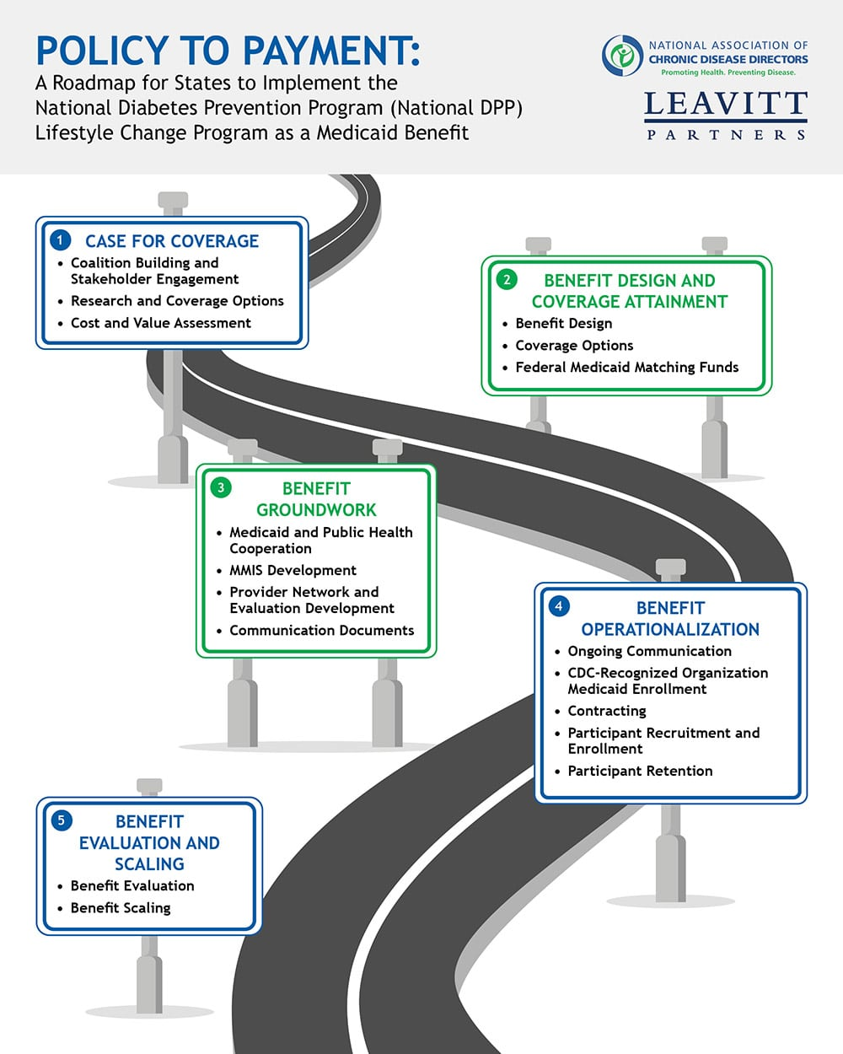
The road to coverage can be organized into five stages.
Medicaid – Public Health collaboration is key.
Notes:
The pathway to Medicaid coverage for the National DPP lifestyle change program can be organized into five stages: case for coverage, benefit design and coverage attainment, benefit groundwork, benefit operationalization, and benefit evaluation and scaling. Medicaid-public health collaboration is key, with both agencies bringing important expertise to the table. The National DPP Coverage Toolkit has detailed information and many resources that states can use during their journey to Medicaid coverage.

Slide 21
You’ll be in good company
Many state Medicaid agencies are covering the program as one way to address rising costs and improve population health.
Be a leader and offer the National DPP lifestyle change program as a covered health benefit!
For more examples, see https://coveragetoolkit.org/participating-payers/
Notes:
Insurers are offering the program to their members across the country. Participating insurers include Medicare, Cigna and Humana. Many more are looking for new solutions to address the mounting costs.
For more examples, take a look at coveragetoolkit.org/participating-payers/
Type 2 diabetes is an issue everyone is concerned about―so be a leader with your members and among your peers. Drive change against this mounting problem and offer [insert name of your program] to your members.

Slide 22
For more information
CONTACT [Insert name/phone/email]
WEBSITE [Insert local website address]
CDC www.cdc.gov/diabetes/prevention
Notes:
For more information on our local program, contact [INSERT contact information].
For information on the National Diabetes Prevention Program and the CDC-recognized lifestyle change program, visit www.cdc.gov/diabetes/prevention.

Slide 23

Questions?
QUESTIONS?
Notes:
Thank you for your time today!
At this time, I’d like to open the floor for any questions you may have.

Slide 24

American Diabetes Association. Economic costs of diabetes in the U.S. in 2022. Diabetes Care. Diabetes Care 2 January 2024; 47 (1): 26–43.
Bardenheier BH, Lin J, Zhuo X, et al. Disability-free life-years lost among adults aged ≥50 years, with and without diabetes. Diabetes Care. 2016;39:1222–1229.
Boyle JP, Thompson JT, Gregg EW, et al. Projections of the year 2050 burden of diabetes in the US adult population: dynamic modeling of incidence, mortality, and prediabetes prevalence. Popul Health Metr 2010;8:1–29.
Centers for Disease Control and Prevention. Diabetes Prevention Recognition Program WORKING WITH EMPLOYERS AND INSURERS GUIDE for CDC-Recognized Organizations. 2017.
Centers for Disease Control and Prevention. National Diabetes Statistics Report website. https://www.cdc.gov/diabetes/data/statistics-report/Index.html. Accessed July 15, 2022.
Diabetes Prevention Programs: Effectiveness and Value Final Evidence Report and Meeting Summary July 25, 2016, Institute for Clinical and Economic Review. Retrieved from https://icer-review.org/wp-content/uploads/2016/07/CTAF_DPP_Final_Evidence_Report_072516.pdf
Diabetes Prevention Program Research Group. 10-year follow-up of diabetes incidence and weight loss in the Diabetes Prevention Program Outcomes Study. Lancet. 2009;374:1677–86.
Dieleman JL, Baral R, Birger Ml, et al. U.S. spending on personal health care and public health, 1996–2013. JAMA. 2016;316:2627–2646.
Knowler, WC, Barrett-Connor, E, et al. Reduction in the incidence of type 2 diabetes with lifestyle intervention or metformin. N Engl J Med. 2002;346(6):393–403.
Rowley WR, Bezold C, Arikan Y, et al. Diabetes 2030: Insights from Yesterday, Today, and Future Trends. Popul Health Manag. 2017;20(1):6-12.
SOURCES CITED

Slide 25

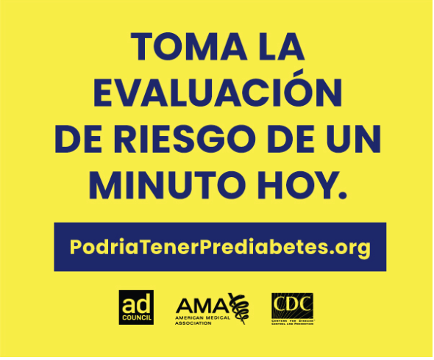
Additional resources
CDC’s National DPP Customer Service Center:
Adaptable promotional materials (English & Spanish)
Videos
Testimonials
Marketing information
https://nationaldppcsc.cdc.gov/s/topic/0TOt000000001QcGAI/marketing-and-recruitment-for-the-national-dpp
Notes:
https://nationaldppcsc.cdc.gov/s/topic/0TOt000000001QcGAI/marketing-and-recruitment-for-the-national-dpp
Additional resources, including press releases, social media, awareness campaigns, and infographics: https://www.cdc.gov/diabetes/resources-publications/media.html

